Slide 1







CALL DATA RECORD
ON INTER OPERATOR SETTLEMENT
TEAM MEMBERS 1.RAHUL SAI 2.IBBANI 3.HIRIJASHREE 4. RAJANALA DURGADEVI

Slide 2


CONTEXT
1.OVERVIEW
2.TOOLS USED
3.ARCHITECTURE
4. DATA FLOW DIAGRAM
5.REQUIREMENTS
6.SAMPLE CODE SNIPPETS
7INDIVIDUAL CONTRIBUTION
8.CHALLENGES FACED & HOW IT ADDRESSED
9.EXPERIENCE GAINED
10.DEMO

Slide 3
OVERVIEW
The Call Data Record on Inter Operator Settlement aim is to display the aggregate information of call record for both operators. The concepts used in this system are to collect and to store the large CDR files (1-5 MB) from CDR generator. The server to process the CDR file, the client uses login authentication, successful login request from the client it is sent to the server for processing CDR in which the file reader to read the file, parse the data and display the output for both operators.

Slide 4
Tools Used
Ubuntu Operating system version 22.1
C++ Language
Draw I.O i s used for Pictorial Representation

Slide 5
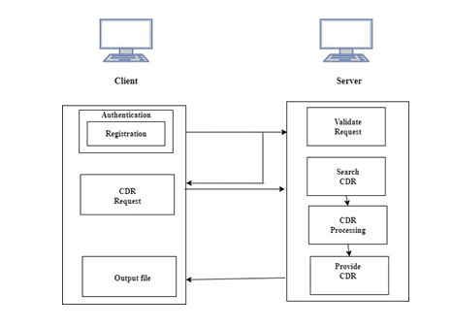
ARCHITECTURE

Slide 6
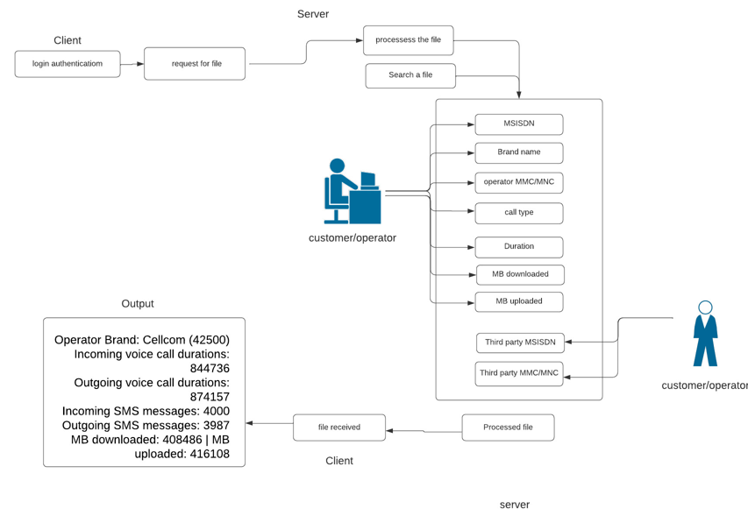
DATA FLOW DIAGRAM

Slide 7

REQUIREMENTS
Client:
1.Registration & Login
2. Send request to server for CDR File
3.Receive the CDR file and store output in file
Server:
1.Accept client request
2.Search CDR File
3.CDR Processing

Slide 8
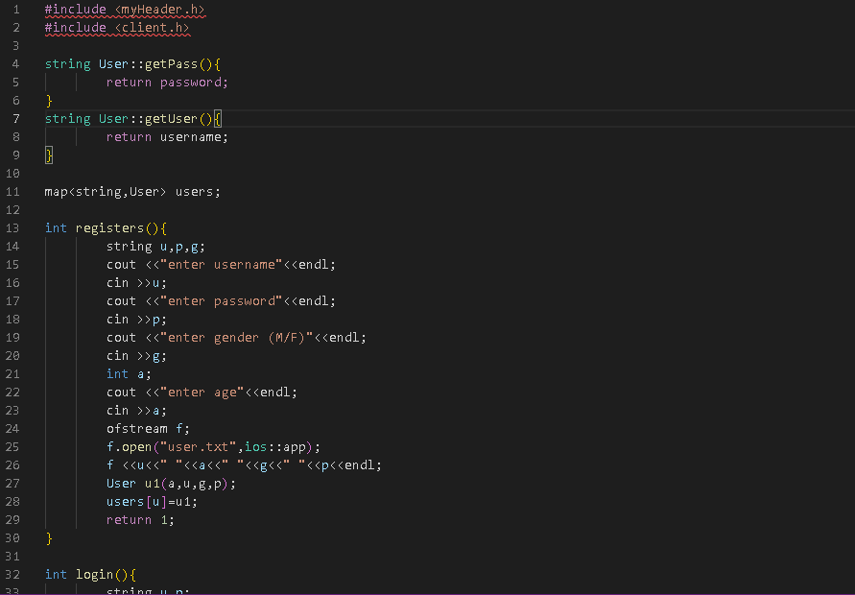
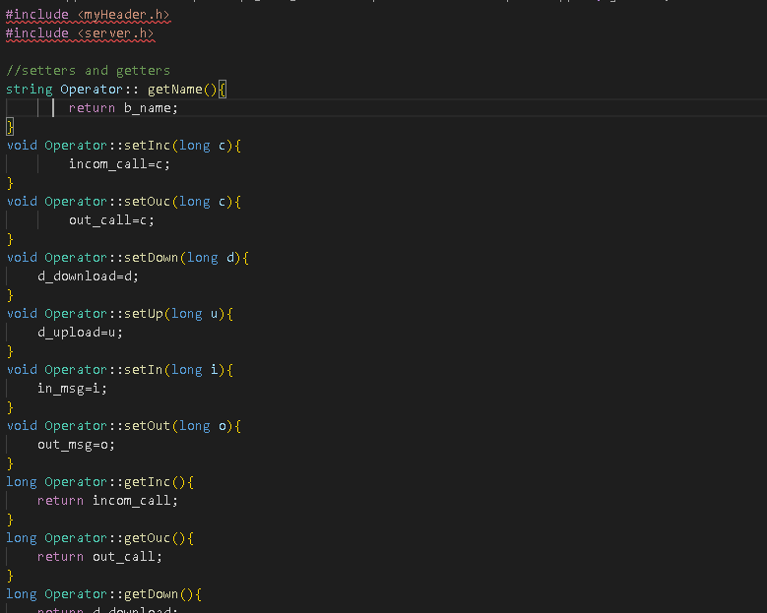
SAMPLE CODE SNIPPETS

Slide 9
INDIVIDUAL CONTRIBUTION
Rajanala Durgadevi
CDR Processing
Story board
Sprint tracker
Test cases
RTM
SRS
Design Document
Hirijashree
Request for CDR and search cdr
Story board
Test cases
PPT
MOM
Architecture Diagram

Slide 10
INDIVIDUAL CONTRIBUTION
Rahul Sai
Login module
Registration Module
Story board
Test cases
User case Diagram
Ibbani
Story board

Slide 11
Challenges faced & how it addressed
Challenges faced | Solutions
Felt difficult to understand requirments Difficult to prepare SRS and Design document Difficult to find functions Not understood how to fill RTM Difficult to merge all functionalities | Understood requirements by going through SRS thoughly Prepared SRS and Design document Found functions Understand about RTM Prepared Final Code

Slide 12
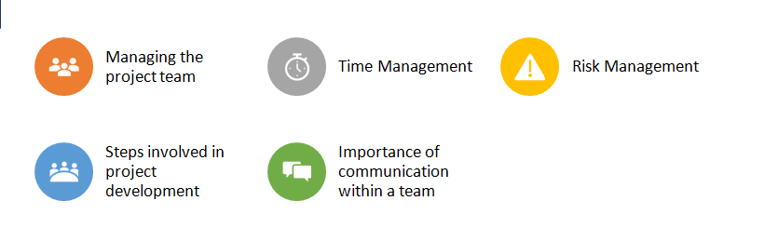
Experience Gained

Slide 13
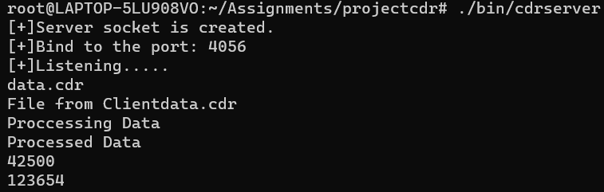
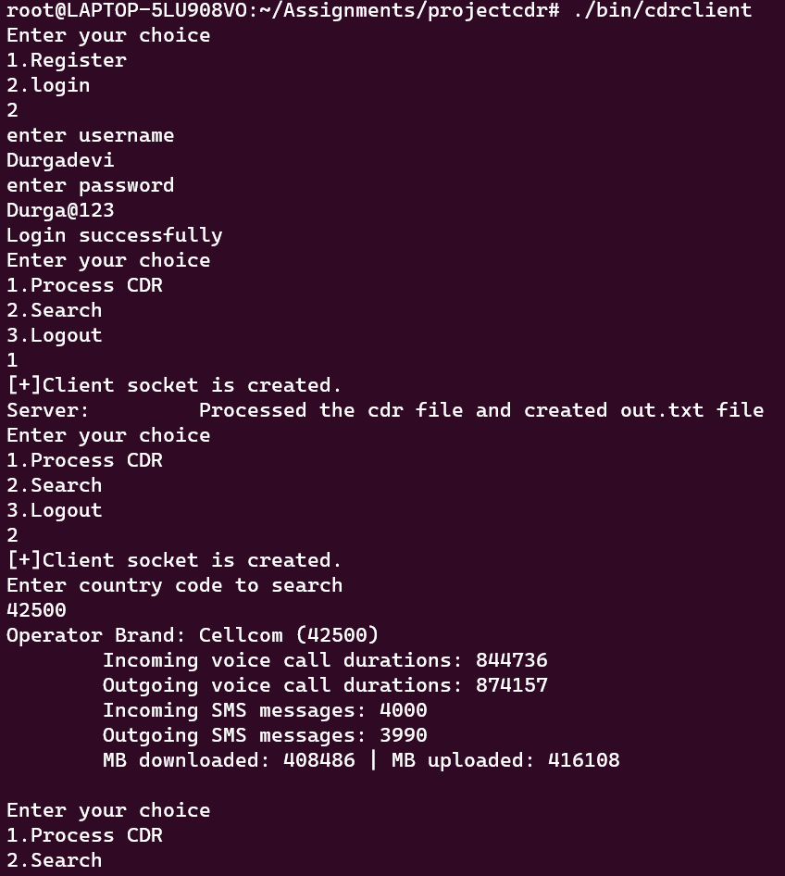
DEMO

Slide 14
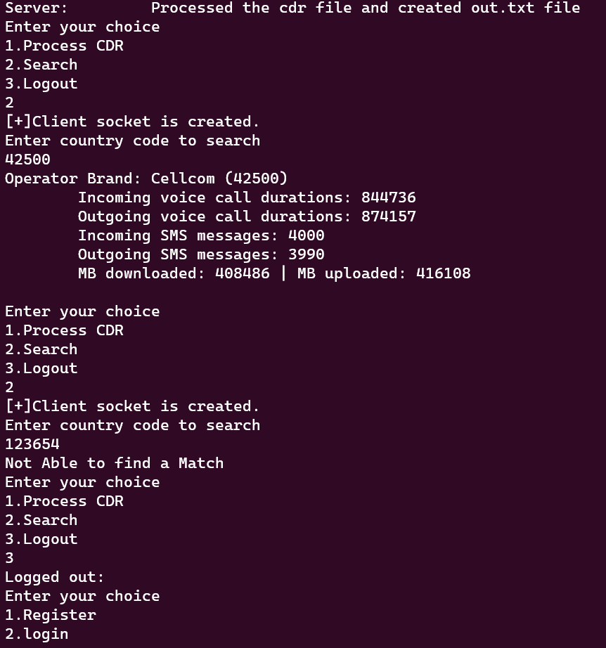
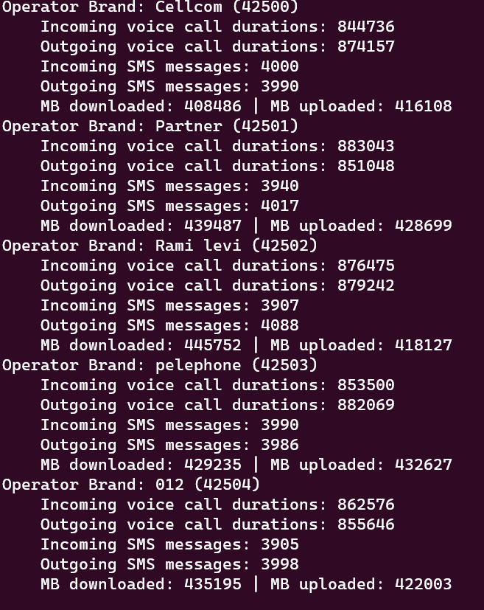

Demo

Slide 15


